Slide 1



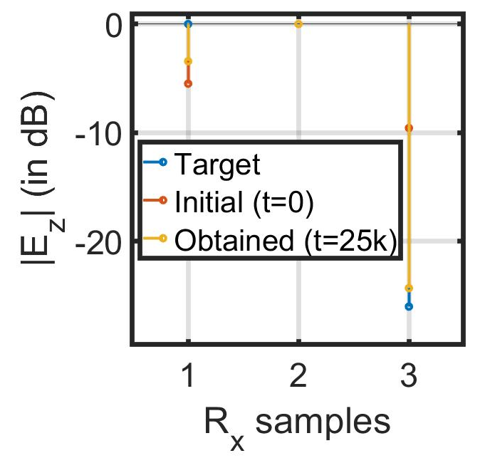
Securing Connected Vehicles, Soldiers, and Platforms in Contested Environments (CRA-4)
This research is supported by U.S. Army Grant No. W911NF2120076
1.6: Distributed Robotic Beamforming
K. Chakrabarti, A. S. Bedi, N. Chopra (UMD),
F. T. Dagefu, J. N. Twigg (ARL)
Server (e.g., auxiliary node) communicates with the autonomous Tx agents.
Acceleration in IPG-DB enables rapid establishment of communication links.
Self-configuring IPG-DB algorithm controls Tx phase+amplitude for covert directional communication without Rx feedback.
Tested in simulated LA urban environment using 6 Tx, 2 target Rx, and 1 adversary.

